Slide 1

Understanding the Impact of Economic, Demographic, Energy Factors & Plastics on Global Warming
Springboard Capstone II Project Report
Sailee Gawande
Notes:
Climate change and pollution are no longer abstract environmental concepts. They are already disrupting ecosystems, biodiversity, and species survival across the planet. This project explores one of the underlying drivers behind this challenge — the relationship between economic growth, energy consumption, and increasingly plastic-intensive global supply chains.

Slide 2
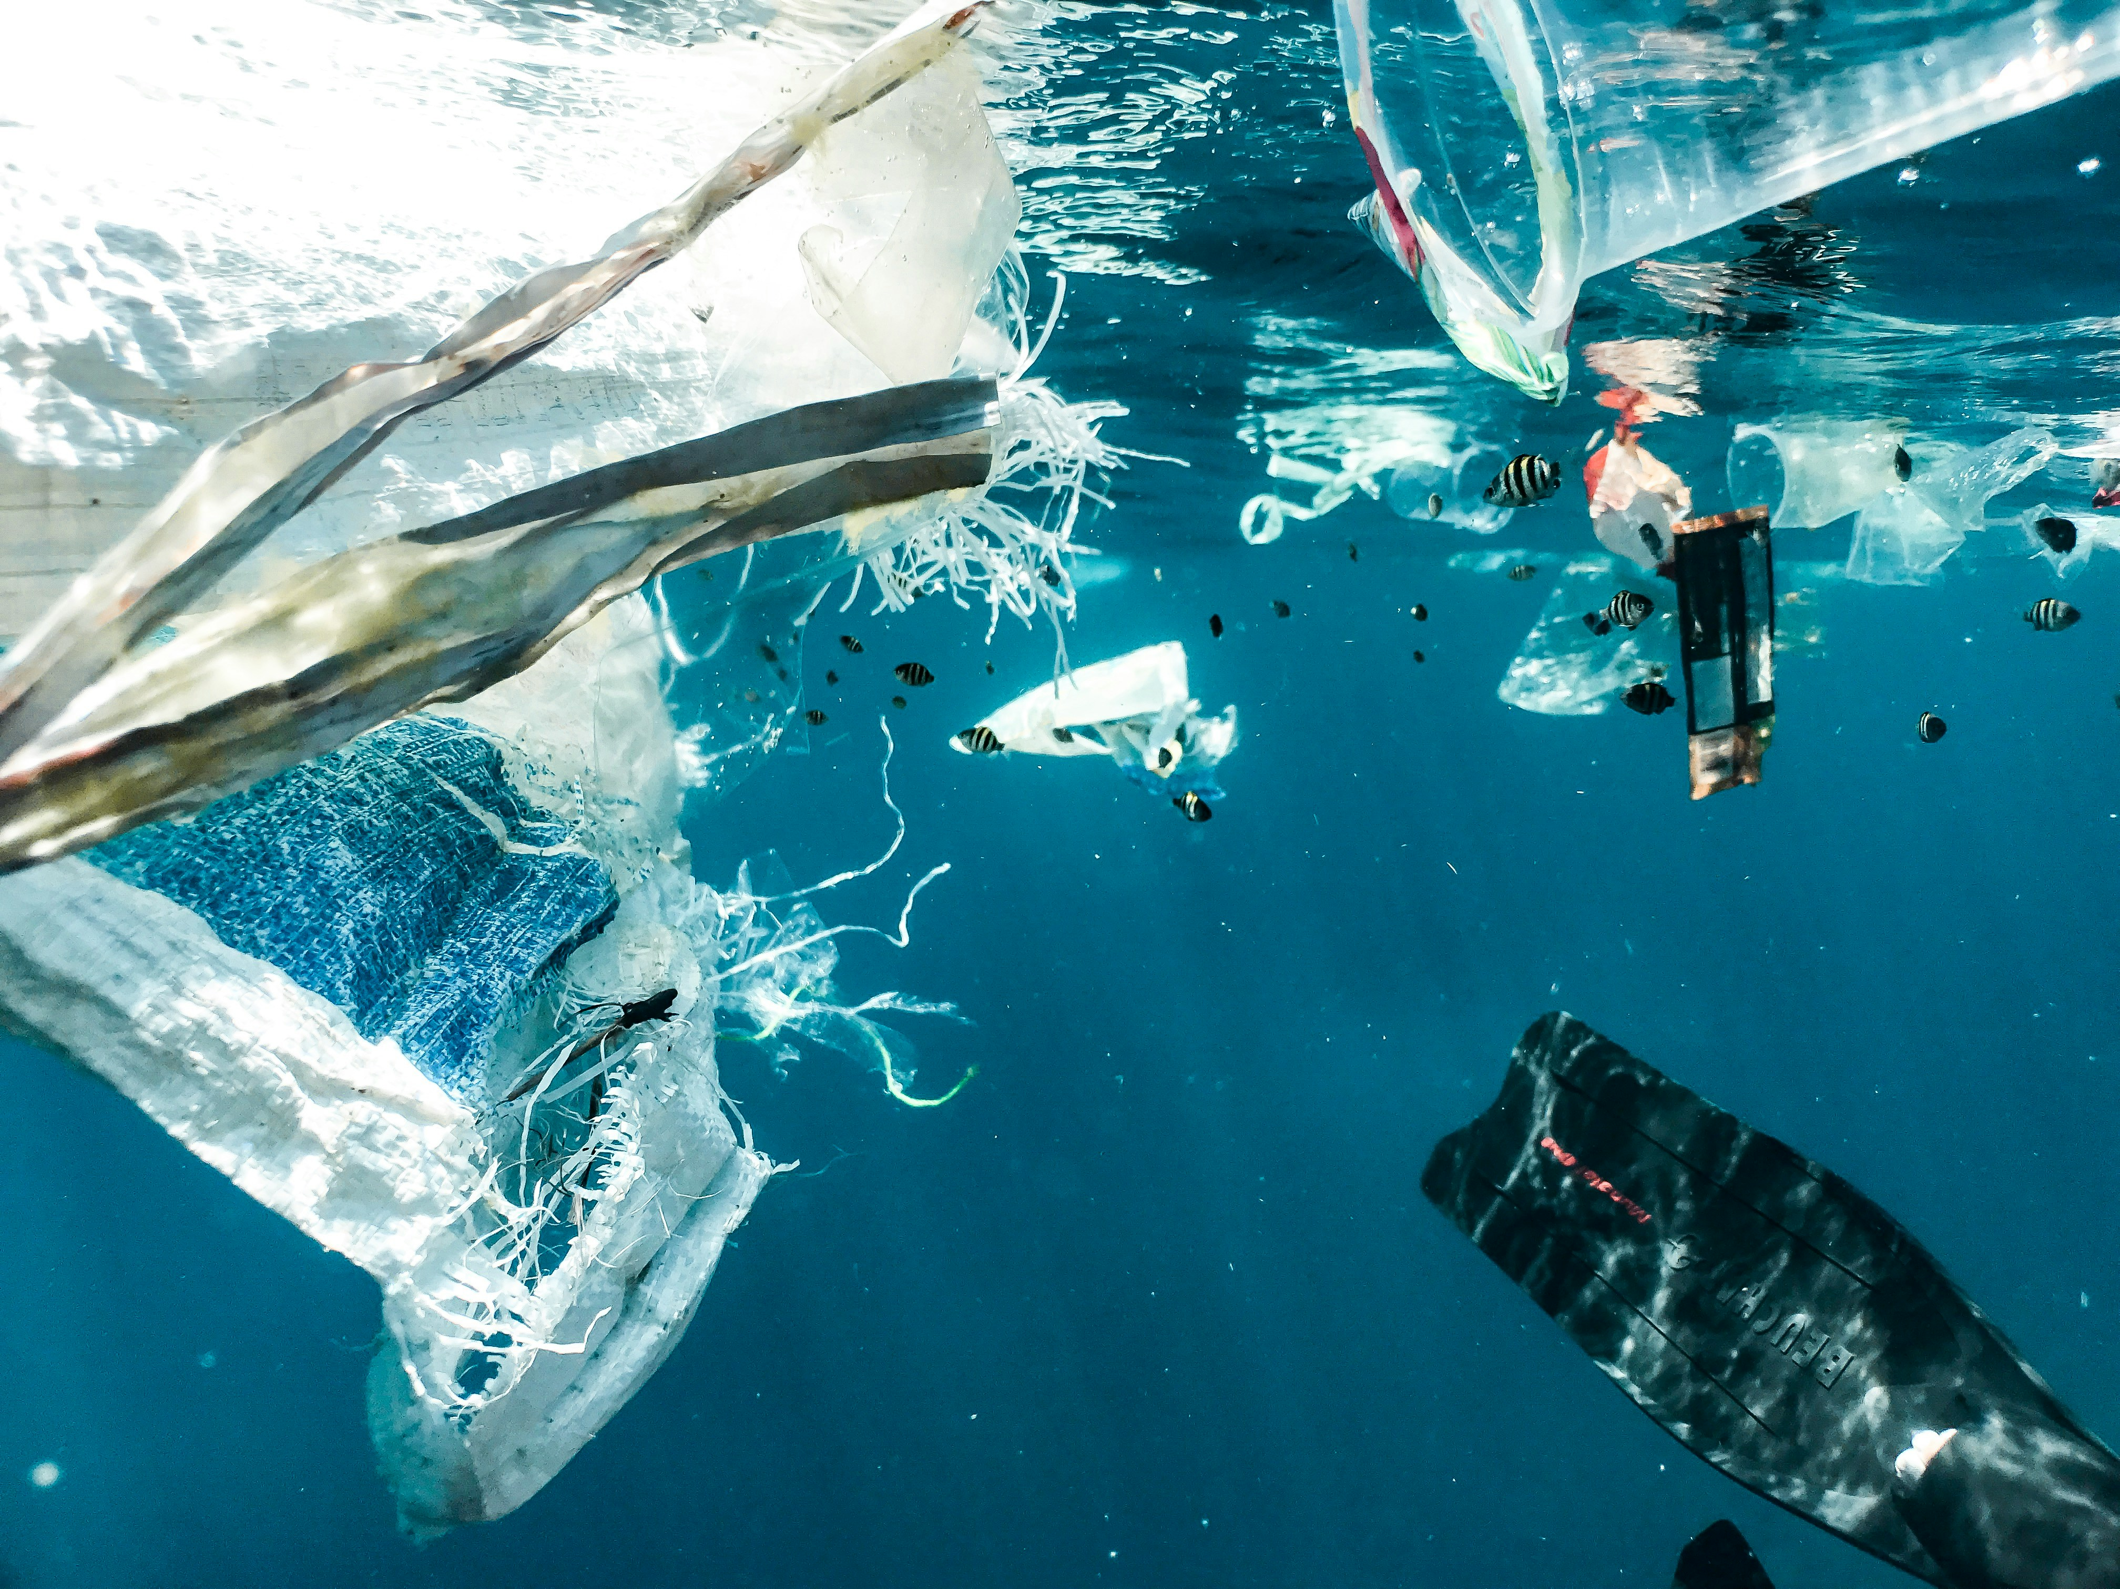

Plastic Pollution
https://www.youtube.com/watch?v=I4QNolP7Khc

Slide 3
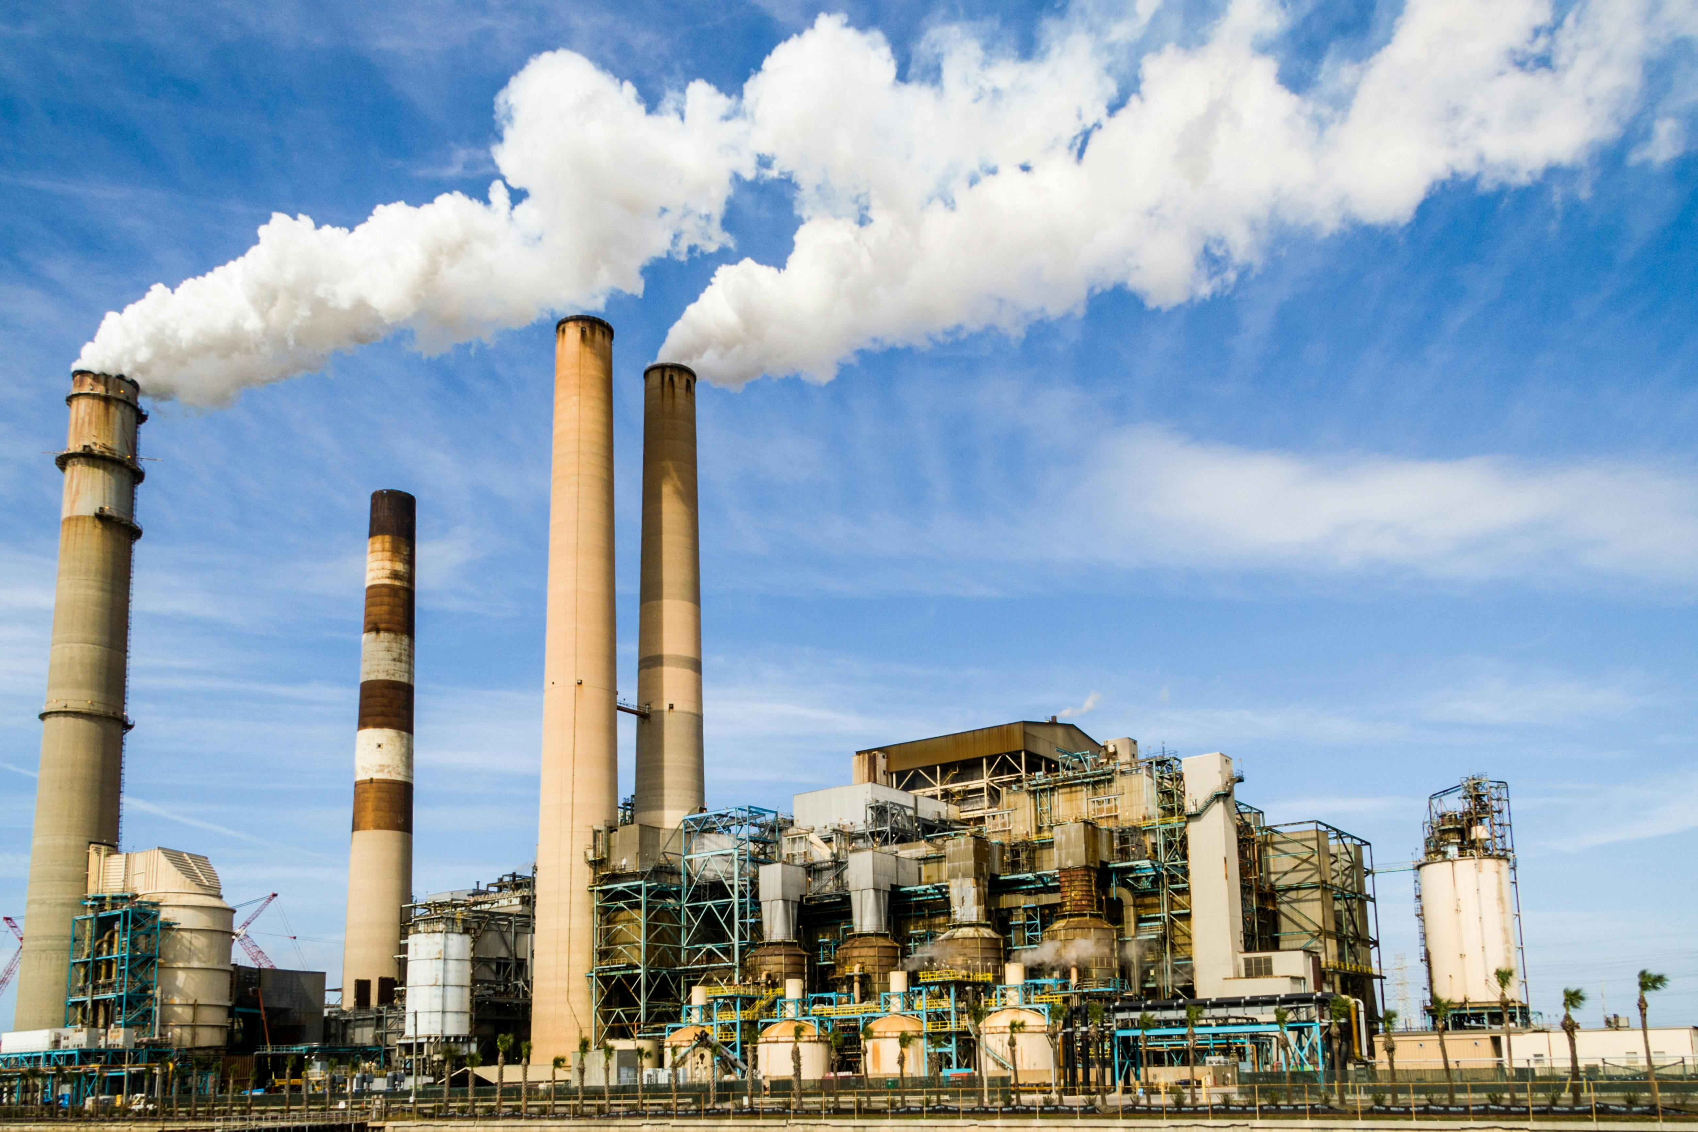
This continues to be a problem because…..
Global CO2 Emissions are up 60% in past 3 decades)
01
Global Plastic Production up ~280% in past 3 decades
02
Global Energy Demand continues to increase as well
03
Energy derived from Fossil Fuels leads to Global Warming
04
Notes:
Key Challenges
Global CO₂ emissions continue to rise
Plastic production has accelerated rapidly
As per an UN article, plastics contributed to ~3.4% of the total greenhouse gas emissions contributing to global warming in 2019. The production of plastics which is mostly from fossil fuels is projected to triple by 2060.
Global Energy demand continues to increase and Supply chains are increasingly energy intensive
Organizations face pressure to meet sustainability goals
Key Question
How do economic activity, energy usage, population growth, and plastics collectively influence global warming?

Slide 4
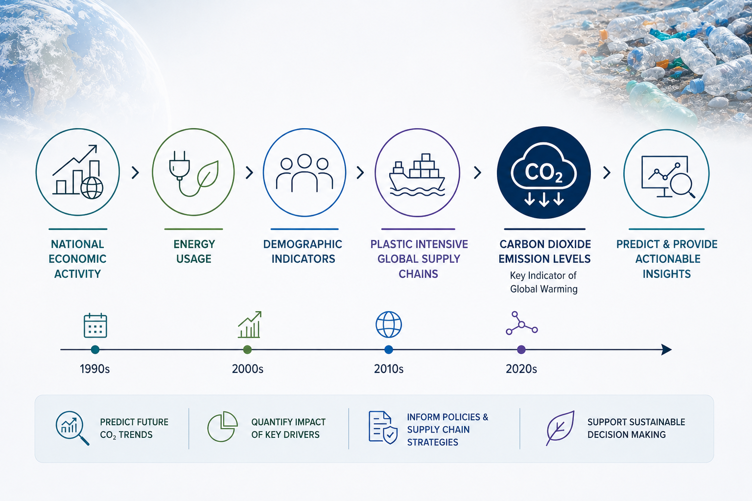
Problem Statement
Problem Statement
Notes:
This project aims to predict and provide actionable insights into how national economic activity, energy usage, and demographic factors influence global warming, using carbon dioxide (CO₂) emissions as the key indicator.
The analysis is conducted within the broader context of increasingly plastic-intensive global supply chains over the past several decades.

Slide 5
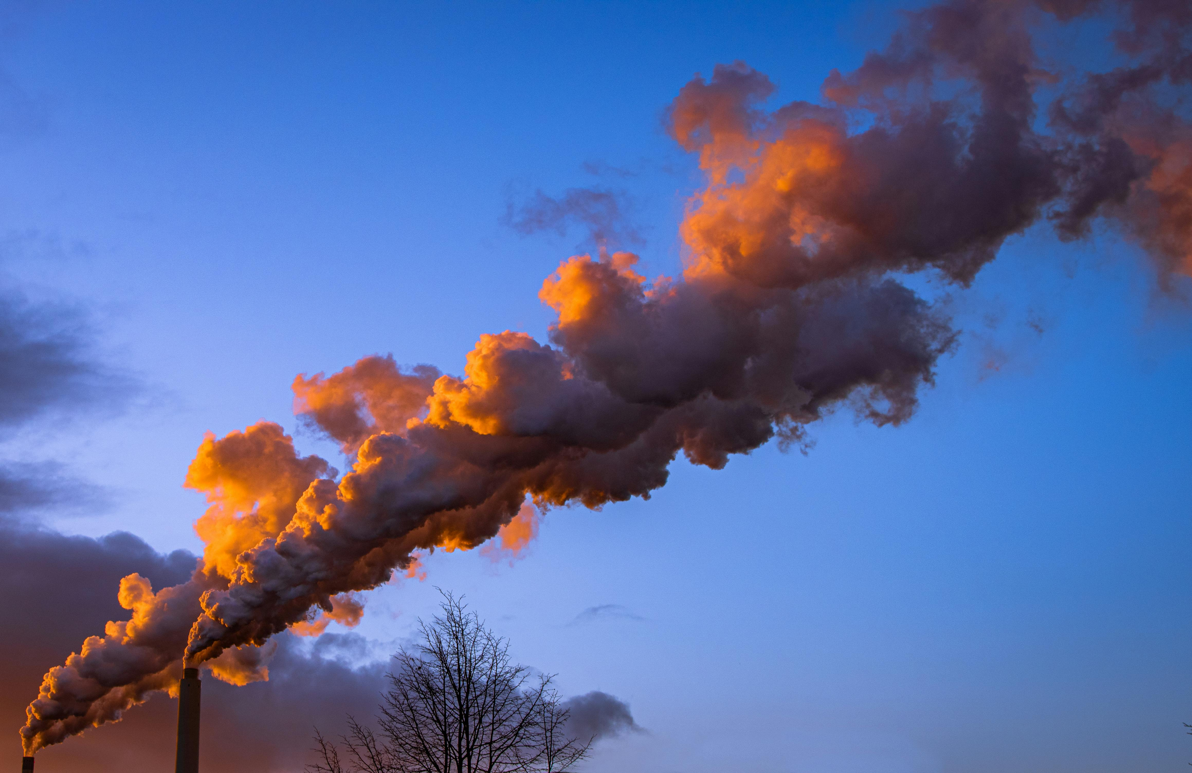
Analysis Objectives
Identify Key Drivers of CO2 Emissions
Compare Total CO2 Emissions Vs. CO2 Per Capita
Contextualize Findings within Rising Plastics Production
Develop Predictive Machine Learning Models
Notes:
Identify key drivers of CO₂ emissions
Compare total emissions vs. emissions per capita
Assess the role of energy consumption
Contextualize findings within rising global plastics production
Develop predictive machine learning models

Slide 6
Datasets Used
The data was acquired from https://ourworldindata.org/
1. Carbon Emissions Data (Country Year Level)
https://raw.githubusercontent.com/owid/co2-data/master/owid-co2-data.csv
Citation : Our World in Data. CO₂ and Greenhouse Gas Emissions [dataset]. Data adapted from the Global Carbon Project. Retrieved from https://github.com/owid/co2-data (accessed 2026).
2. Global Plastics Production Data (Global Year Level)
https://ourworldindata.org/grapher/global-plastics-production
Citation :Geyer, R., Jambeck, J., and Law, K. (2017) – with processing by Our World in Data. Global plastics production [dataset]. Retrieved from https://ourworldindata.org/grapher/global-plastics-production (accessed 2026).
Notes:
Dataset 1 — CO₂ Master Dataset
Country-year level data
1990–2019
Features:
GDP
Population
Energy per capita
CO₂ emissions
Dataset 2 — Global Plastics Dataset
Global yearly plastic production
1950–2019
Source
Our World in Data

Slide 7
Data Wrangling
Key Steps
Reduced CO2 Dataset from 79 to 10 relevant columns
Removed non-country entries
Filtered both Plastics and CO2 Datasets for 1990-2019 Timeframe
Handled missing values
Created merged Global CO2 + Plastics Dataset
Standardized Units
Final Datasets
CO2 Master Country Year Level Dataset for Modeling
Global CO2 + Plastics Dataset for Trends Analysis
Notes:
Key Steps
Reduced CO₂ dataset from 79 → 10 columns
Removed non-country aggregates
Filtered timeframe to 1990–2019
Handled missing values
Created global merged CO₂ + plastics dataset
Standardized units
Final Datasets
Country-year modeling dataset
Global trend analysis dataset

Slide 8
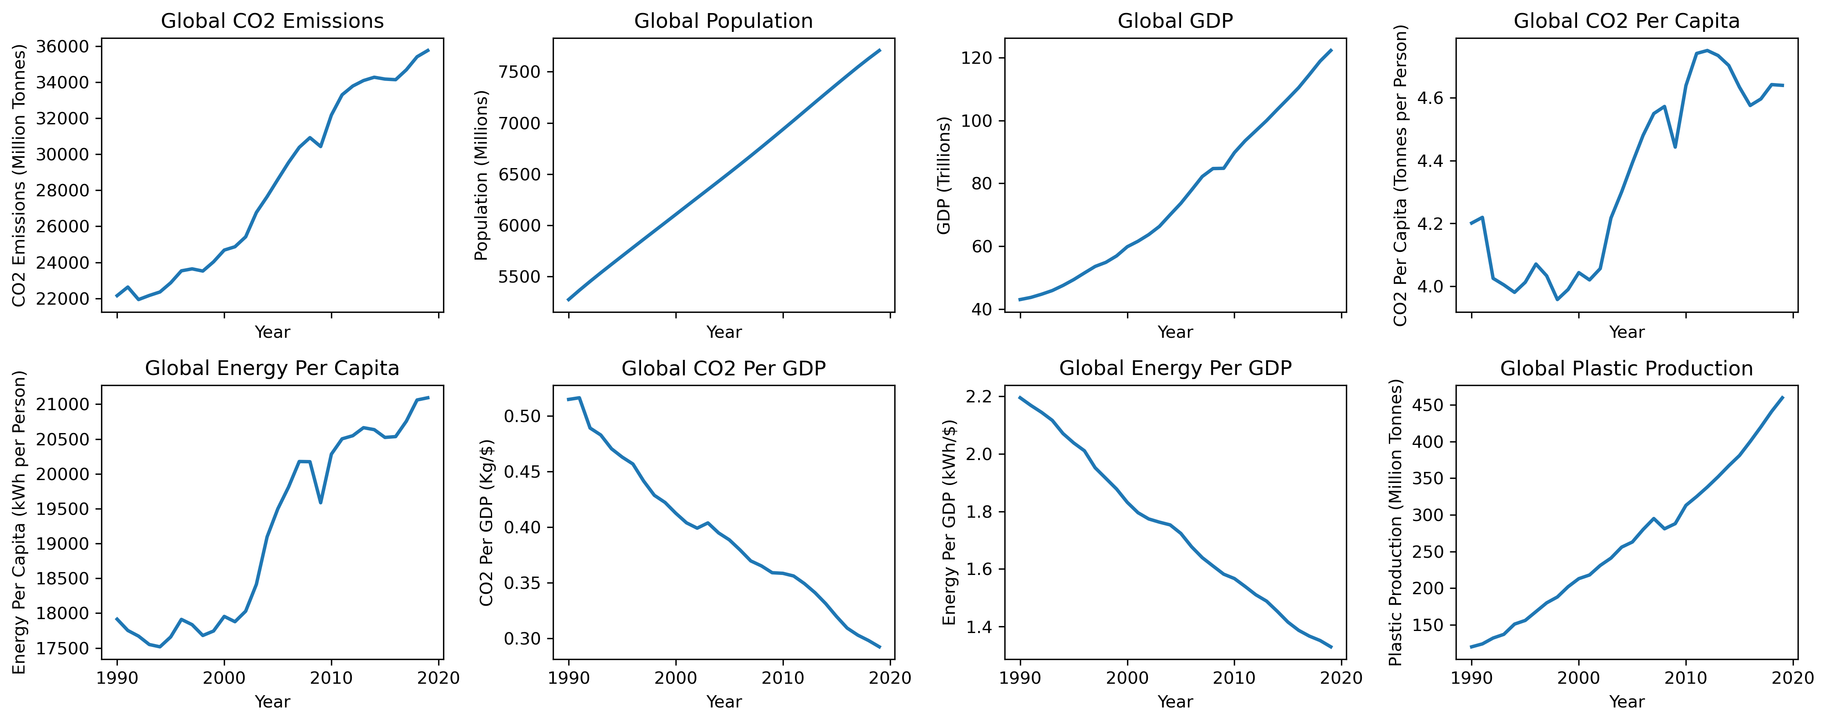
Global Trends
Notes:
Global Trends (1990–2019)
Key Findings
GDP increased
Population increased
Energy consumption increased
Plastic production increased sharply
CO₂ emissions continued rising
Important Observation
Although energy efficiency improved over time:
CO₂ per GDP decreased
Energy per GDP decreased
…the scale of global growth outweighed these gains.

Slide 9
Exploratory Data Analysis
Key Insights
Energy per capita is strongly correlated with CO2 Emissions
Higher GDP → Higher CO2 Emissions
Higher Population Size → Higher Total CO2 Emissions
Developed countries show signs of decoupling
Important Observation
Emissions stabilized for some developed countries despite economic growth
Notes:
Country-Level EDA Findings
Major Insights
Energy per capita strongly correlated with CO₂ emissions
Higher GDP → higher emissions
Larger populations → higher total CO₂ emissions
Developed countries show signs of decoupling
Important Observation
Some countries stabilized emissions despite economic growth.

Slide 10
Feature Engineering & Preprocessing
Key Steps
Log Transformation of Skewed Features
PCA Transformation of Features for Multicollinearity
Standardization of Features
Time aware Train/Test Splits for 2 Modeling Approaches
Total CO2 Emissions as Target
CO2 per Capita as Target
Notes:
Steps Performed
Log transformation of skewed variables
Standardization of numerical features
Time-aware train/test split
PCA analysis for multicollinearity assessment
PCA Outcome
PCA was not used because:
Only 3 core features existed
Multicollinearity was manageable
PCA reduced interpretability

Slide 11
Modeling Strategy
Modeling Approaches
Models Used : Ordinary Least Squares with country fixed effects (Scaled & Unscaled), Scaled Ridge Regression , Random Forest Model
Evaluation Metrics : R², RMSE, MAE
Approach | Target Variable | Features
1st Strategy | log_co2 | log_energy_per_capita, log_gdp_per_capita, log_population
2nd Strategy | log_co2_per_capita | log_energy_per_capita, log_gdp_per_capita
Notes:
Modeling Approaches
Target Variables
Strategy 1
log_co2
Strategy 2
log_co2_per_capita
Models Implemented
Ordinary Least Squares Model (Scaled and Unscaled).
Scaled Ridge Regression Model with Hyperparameter Tuning, Cross Validation & Feature Importance Assessment.
Random Forest Model with Hyperparameter Tuning, Cross Validation & Permutation Importance for Feature Importance Assessment.
Evaluation Metrics
R²
RMSE
MAE

Slide 12
Model Performance Summary & Selection
Notes:
Findings
Total CO₂ models achieved higher R²
CO₂ per capita models provided better interpretability
While total CO₂ emissions capture overall scale, CO₂ per capita provides a more interpretable measure of emissions intensity by normalizing for population, allowing for meaningful comparisons across countries and clearer insights into energy efficiency and sustainability behavior.
Ridge Regression performed best overall
Final Model
Ridge Regression (CO₂ per capita)
Why?
Stable
Interpretable
Handles multicollinearity
Strong predictive performance

Slide 13
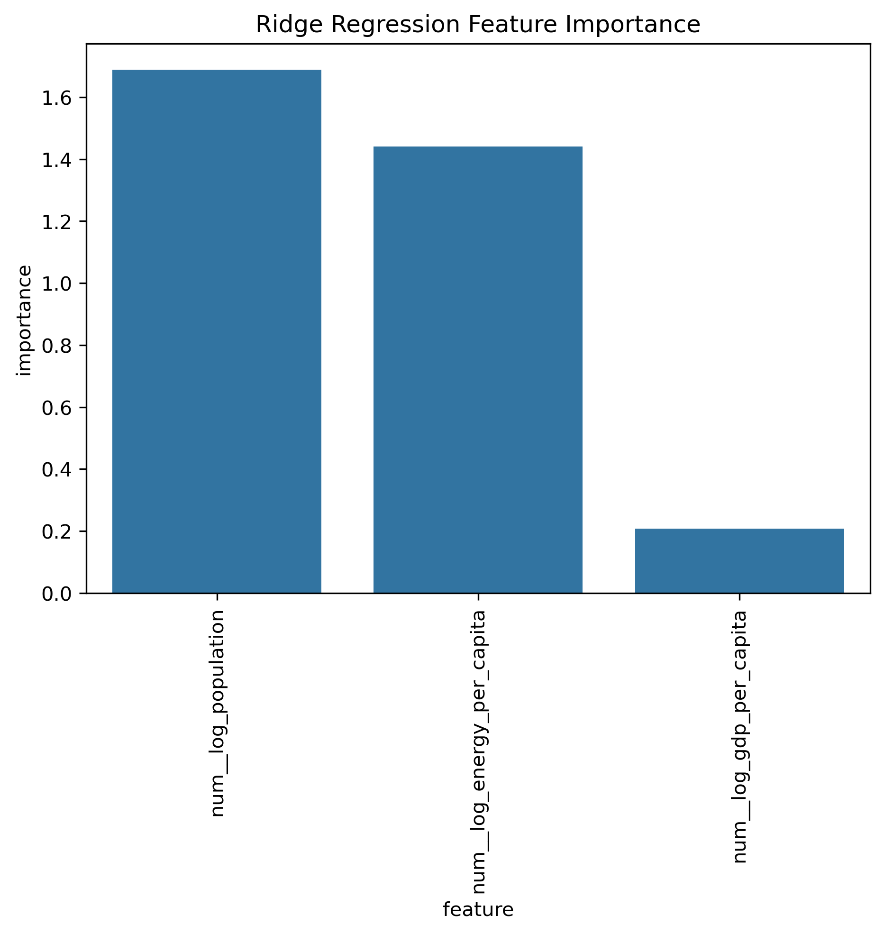
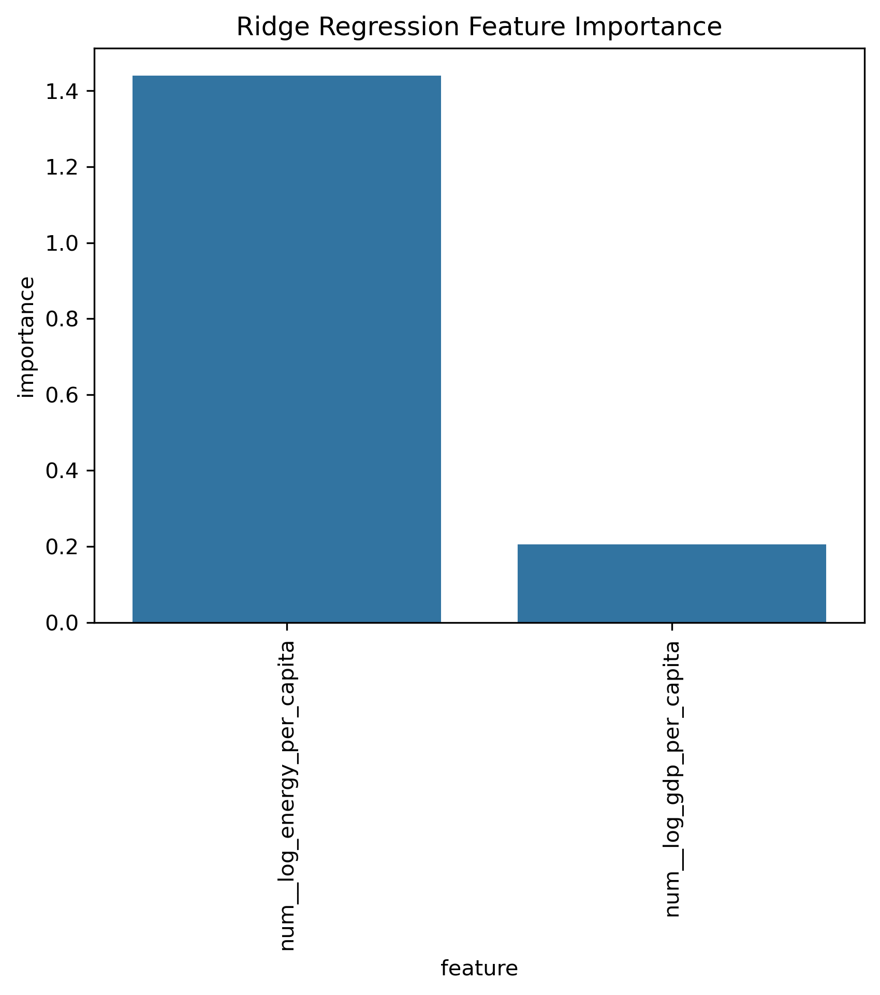
Feature Importance
With Population Signal for Total CO2 Emissions
Without Population Signal for CO2 per Capita
Notes:
Key Drivers of CO₂ Emissions
Ridge Regression + Random Forest Results
Strongest Predictor
Population for Total CO2 Emissions and
Energy Consumption Per Capita for co2_per_capita
Secondary Predictor
GDP Per Capita
Lower Influence
Country-specific effects
Key Insight
Energy usage behavior matters more than economic size alone.

Slide 14
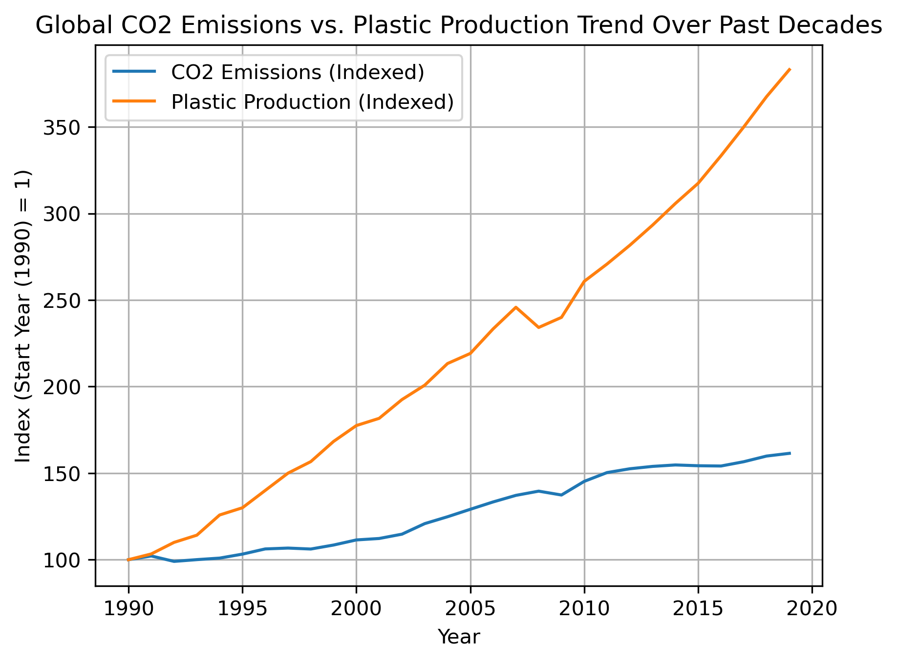
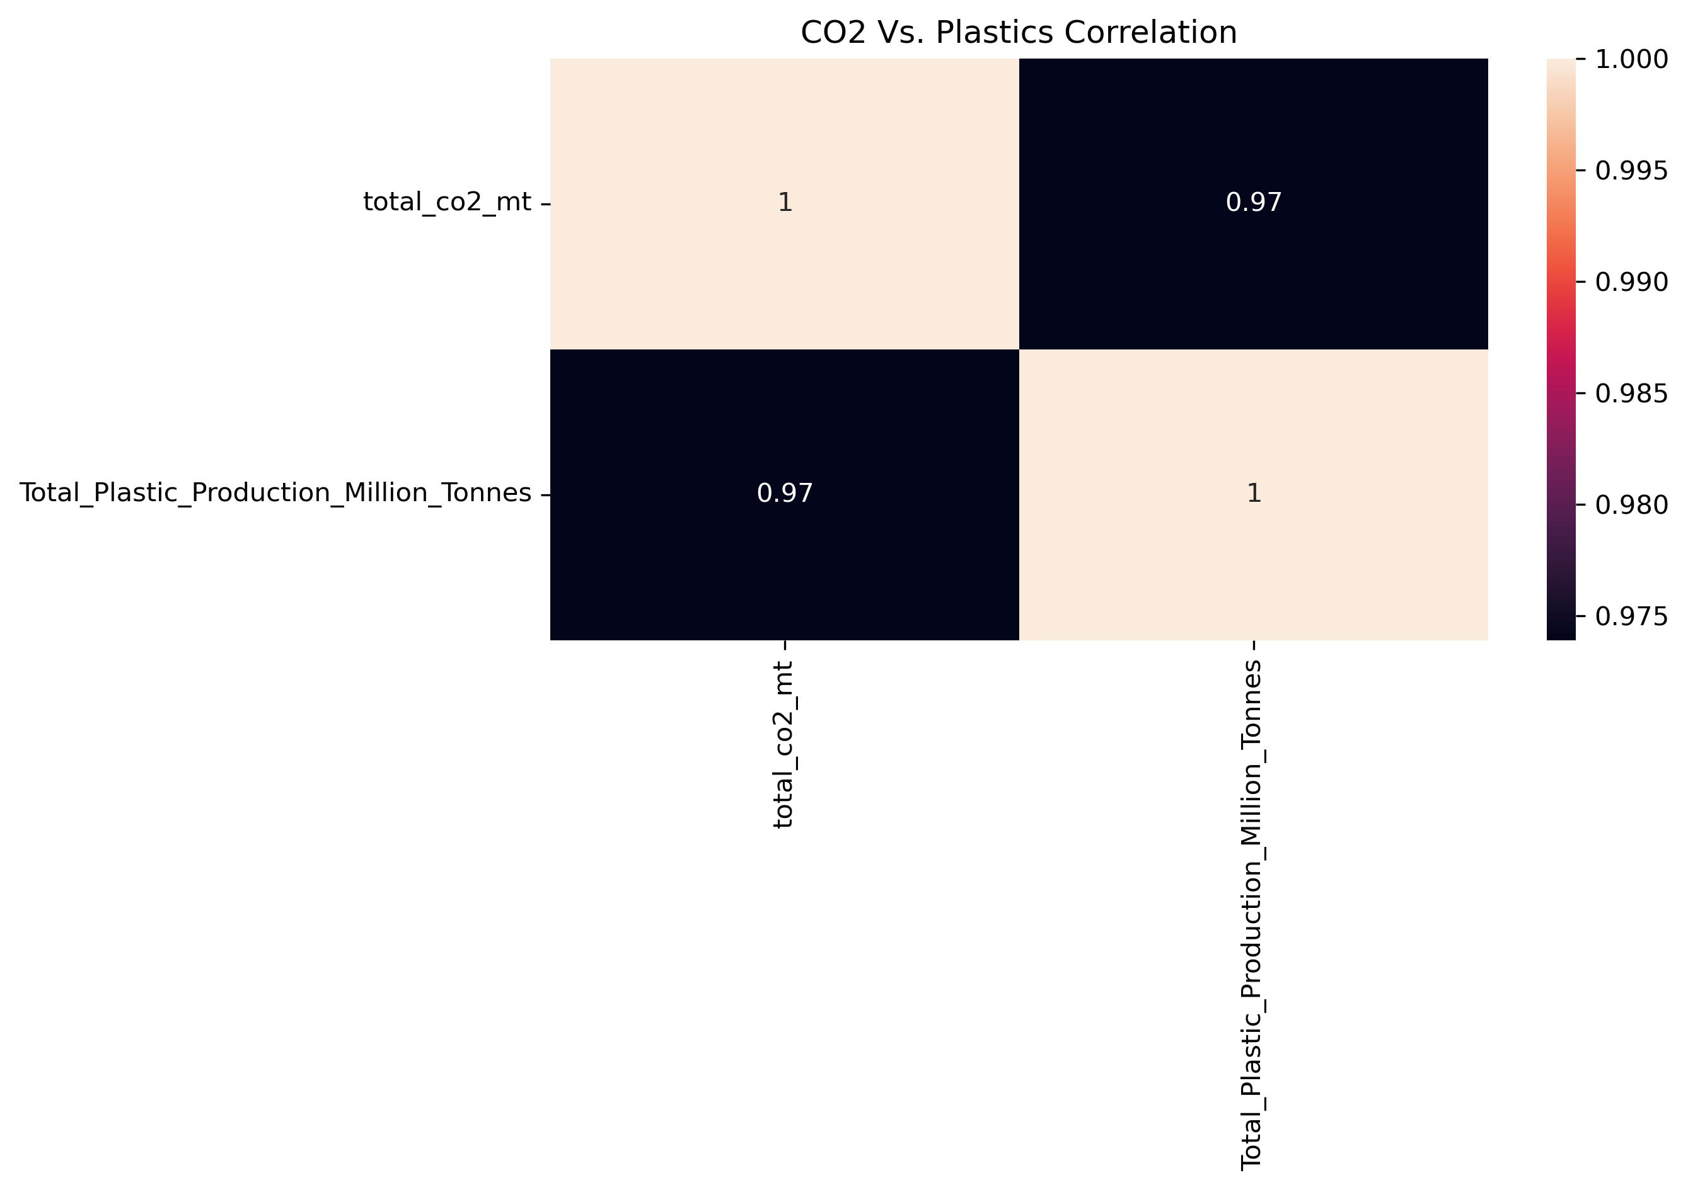
Plastics Connection
Notes:
Key Insight
Plastic production increased at a steeper rate than CO₂ emissions.
Interpretation
Indicates increasing material intensity in supply chains
Suggests growing fossil fuel dependency
Adds pressure on global energy demand

Slide 15
Key Findings
Population Size drives Total CO2 Emissions
Energy Demand drives CO2 Emissions Intensity
GDP drives CO2 Emissions indirectly via Energy Demand
Decoupling of Emissions with Economic Growth exists but not always
Plastic Intensive Supply Chains increase environmental pressure
Notes:
Population drives total emissions
Energy drives emissions intensity
GDP influences emissions indirectly through energy demand
Decoupling exists but is incomplete
Plastic-intensive supply chains increase environmental pressure

Slide 16
Actionable Recommendations
Track both CO2 per capita and CO2 Emissions for all major energy intensive industries & processes within a country
Invest in energy efficient technologies
Incentivize green/renewable energy sources
Invest in recycling and improving Supply Chain sustainability
Reduce dependence on plastics by investing in greener alternatives
Notes:
Policy
Track both CO2 per capita and CO2 Emissions for all major energy intensive industries & processes within a country
Energy
Invest in energy efficient technologies
Such as…
renewable energy
Electrifying supply chains
Plastics
Improve recycling systems
Improve Supply Chain sustainability and reporting
Reduce virgin plastic dependency
Promote circular economy practices

Slide 17
Future Work
Add country/year level plastics data
Add renewable energy indicators
Explore panel regression models
Build forecasting dashboard
Notes:
Potential Improvements
Add country-level plastics data
Include renewable energy indicators
Apply panel regression models
Build forecasting dashboard

Slide 18
Conclusion
Energy consumption behavior has the highest environmental impact
Energy Efficiency gains offset by scale of growth, energy demand, population and rapidly increasing plastic supply chains
Final Insight
Global Warming mitigation will not just require cleaner energy systems but also reducing material intensity for global supply chains
Notes:
Conclusion
This study demonstrates that energy consumption per capita is the strongest driver of emissions intensity globally.
While efficiency gains have improved over time, the rapid expansion of plastic-intensive supply chains continues to increase environmental pressure.
Final Insight
Sustainable climate action will require not only cleaner energy systems, but also a reduction in the material intensity of global supply chains.

Slide 19
Thank You!
Questions?
Contact Information : gawandesailee@gmail.com
LinkedIn : www.linkedin.com/in/saileegawande
GitHub Repository : https://github.com/gawandesailee-lab/learndsp/blob/main/Data%20Science%20Capstone%202%20Project/reports/Data%20Science%20Capstone%202%20Project%20Report.pdf

